Slide 1




EMPLOYEE PERFORMANCE ANALYSIS USING EXCEL
PRESENTED BY: V.Nireeksha
➢
REG NO: 7305437237
D➢EPARTMENT:COMMERCE COLLEGE: ANNAIVELLANKANNI COLLEGE FOR WOMEN
➢

Slide 2
AGENDA
➢PROLEM STATEMENT
➢PROJECT OVERVIEW
➢END USERS
➢OUR SOLUTION AND PROPOSITION
➢DATASET DESCRIPTION
➢MODELLING APPRROACH
➢RESULTS AND DISCUSSION
➢CONCLUSION

Slide 3
PROBLEM STATEMENT
➢EASY DATA MANAGEMENT
➢
➢
DATA ORGANANISATION
AUTOMATION
➢EASE OF USE
➢VERSATILITY
➢COLLABORATION

Slide 4
WHO ARE THE END USERS
➢EM PLOYE ES
➢ORGANISATION
➢FIRM
➢BUSINESS
➢M AN AGE R/ SU PERV I SO R
➢HUMAN RESOURCES
➢
CUSTOMERS

Slide 5
OUR SOLUTION AND PROPOSITION
➢ ➢ ➢
FILLTERING-REMOVE MISSING VALUES
CONDITIONAL FORMATTING-BLANKS PIVOT TABLE-SUMMARY OF EMPLOYEE
PE RFORM AN CE
➢FORMULAS-IF CONDITION
➢GRAPHS-FINAL REPORT

Slide 6
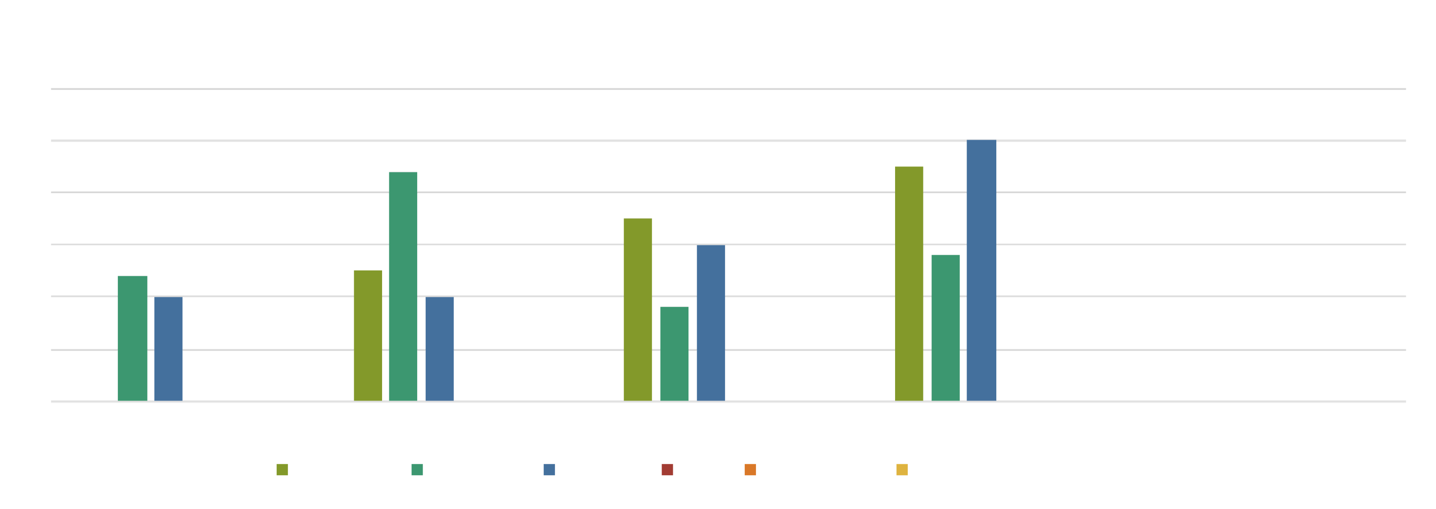
DATASET DESCRIPTION
FITNESS PROGRESS CHART
6
5
4
3
2
1
0
05-03-2013
05 -11 -20 13
CHEST 2
5/0 90 20 13 HIP
HIP FOREARM ESTIMATED LIEN BODY
FOREAM
WE IG HT
WA I ST

Slide 7
MODELLING APPROACH
DATASET KAGGLE,EMPLOYE DATASET
FEATURE SELECTION
DATA CLEANING-MISSING VALUES,IRREVELENT THINGS REMOVED
FORMULA-PERFORMANCE(LOW,MEDIUM,HIGH)
PIVOT TABLE-SUMMARY BUSINESS,GENDER,EMPLOYEE TYPE,EMPLOYEE ID,PERFORMANCE
CHART-REPORT,LICENCE,

Slide 8
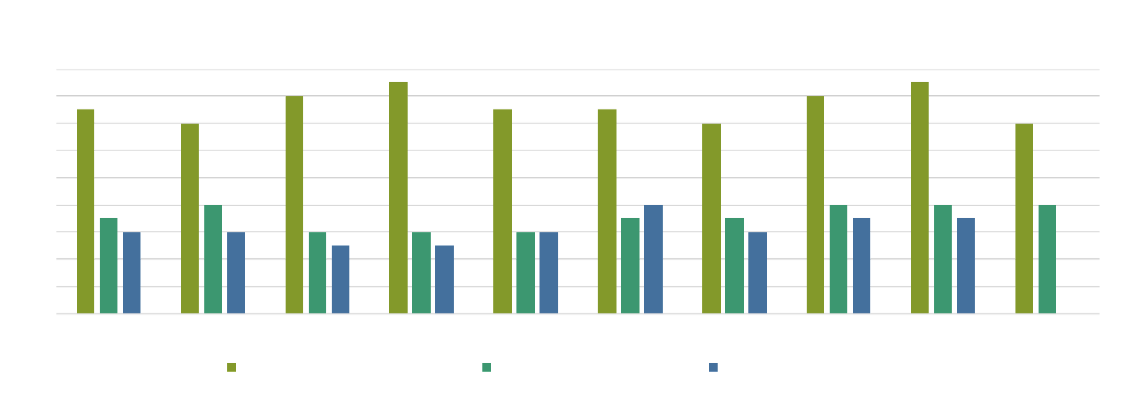
RESULTS
PEFORMENCE CATEGORY DISTRIBUTION BY DEPARTMENT
180
160
140
120
100
80
60
40
20
0
BPC
CCDR
EW MSC
AVERAGE PEFORMENCE
NEL PL
LOW PERFORMANCE
PYZ SVG
HIGH PERFORMANCE
TNS
WBL

Slide 9
CONCLUTION
IN THIS PRESENTATION CONCLUD ,
BOOST EMPLOYEE ENGAGEMENT AND PRODUCTIVITY
OPTIMIZE TALENT DEVELOPMENT AND RETENSION
ACHIEVE A COMPETITIVEEDGE IN THE MARKET
STRATEGIES

Slide 10
THANK YOU

